Slide 1
Long multiplication Long division
Remember, any multiplication can be reversed in 2 ways, using division:

Slide 2
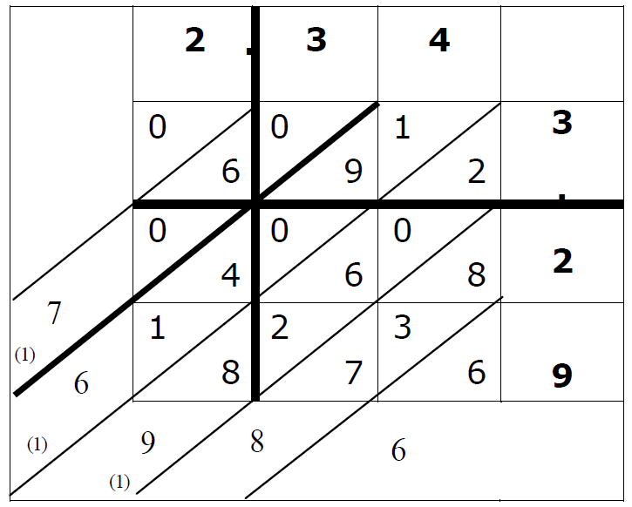
Ways to multiply (1) – lattice method
If you only know the lattice method, long division will not make sense

Slide 3
Ways to multiply (2a) – long multiplication

Slide 4
Ways to multiply (2b) – long multiplication
Can we reverse the process?

Slide 5
Division
“We need an easy way of splitting it into single digit multiples of 457”
We will see how in a moment…first, let’s start with something simpler.

Slide 6
Short division (simple example, part1)
Swop the numbers and write a division sign:
How many 3’s go into 7? “2, remainder 1”
2 is in the thousands column.
We have “made” 2000×3=6000 so far. Now, how many 3’s go into the remaining 1854?

Slide 7
Short division (simple example, part 2)
How many 3’s go into 18? “6, remainder 0”
26 means 2600.
We have “made” 2600×3=7800 so far. Now, how many 3’s go into the remaining 54?
How many 3’s go into 5? “1, remainder 2”
261 means 2610.
We have “made” 2610×3=7830 so far. Now, how many 3’s go into the remaining 24?

Slide 8
Short division (simple example, part 3)
How many 3’s go into 24? “8, remainder 0”
You can use short division with a longer divisor (e.g. 457) but long division is easier.
We do the same thing, but write out each subtraction to make it clearer

Slide 9
Long division (1 digit example)
2000×3=6000 (less than 7854, OK) but 3000×3=9000 would be too big
This is just to show how long division works.
You do not need long division for such an easy question.
We repeat the process until there is no remainder left!

Slide 10
Long division (1 digit example)
600×3=1800 (less than 1854, OK) but 700×3=2100 would be too big
Carry on…

Slide 11
Long division (1 digit example)
10×3=30 (less than 54, OK) but 20×3=60 would be too big
Carry on…

Slide 12
Long division (1 digit example)
8×3=24 as required.
Remainder 0 so we have finished.

Slide 13
Long division with a long divisor (a)

Slide 14
It’s just like long multiplication, but subtracting instead of adding!
Dividing:
Multiplying:

Slide 15
Long division with a long divisor (b)

Slide 16
Long division of decimals
We can make the division easier by multiplying each side by a power of 10 until we have at least one integer
EQUIVALENT FRACTIONS.
Remember the “decimal places” rule.

