Slide 1
Tessalation

Slide 2
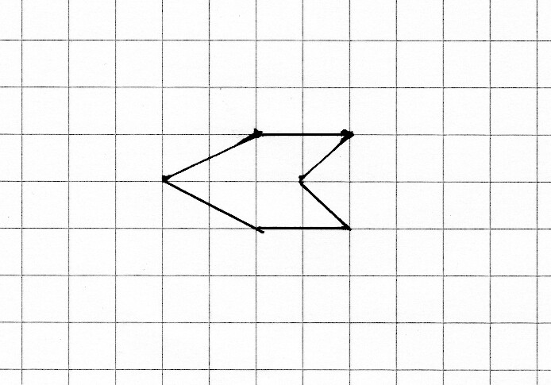
How do we cover a surface with this shape, without leaving any gaps?
Most tessalations can be done by translating and rotating the shape so it meshes with itself.

Slide 3
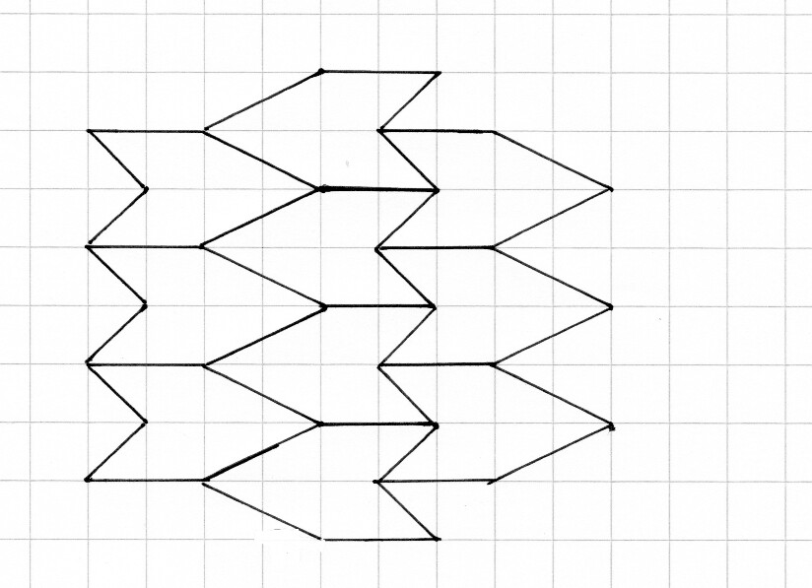

Slide 4
How can one tessalate hexagonal tiles?
Why is it possible?

Slide 5
The interior angle = 180-60 = 120°. Three hexagons can meet at a point without a gap because 3×120°=360°

Slide 6
Can one tessalate pentagons?
Why not?
The exterior angle is 72° so the interior angle = 180-72 = 108°. Three pentagons cannot meet at a point without a gap because 360° is not a multiple of 108°

