Slide 1
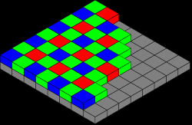
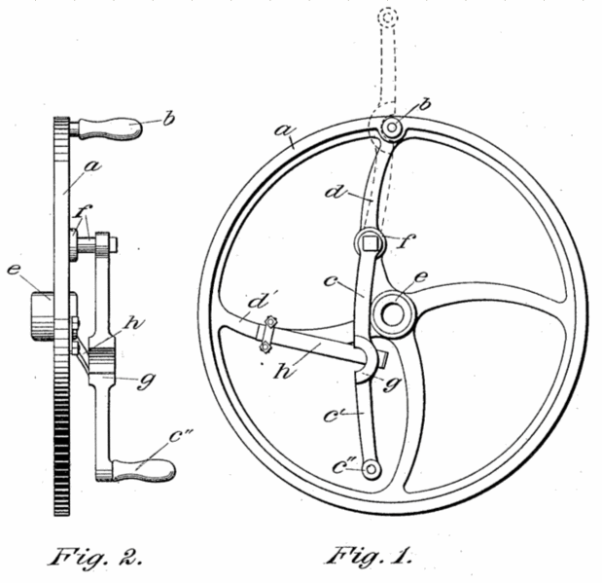
Ways of drawing 3D objects in 2D
Perspective views, eg
isometric
Orthographic projection:
Multiple views of an object, seen from directions in 90° intervals (“plan” & “elevation”)

Slide 2
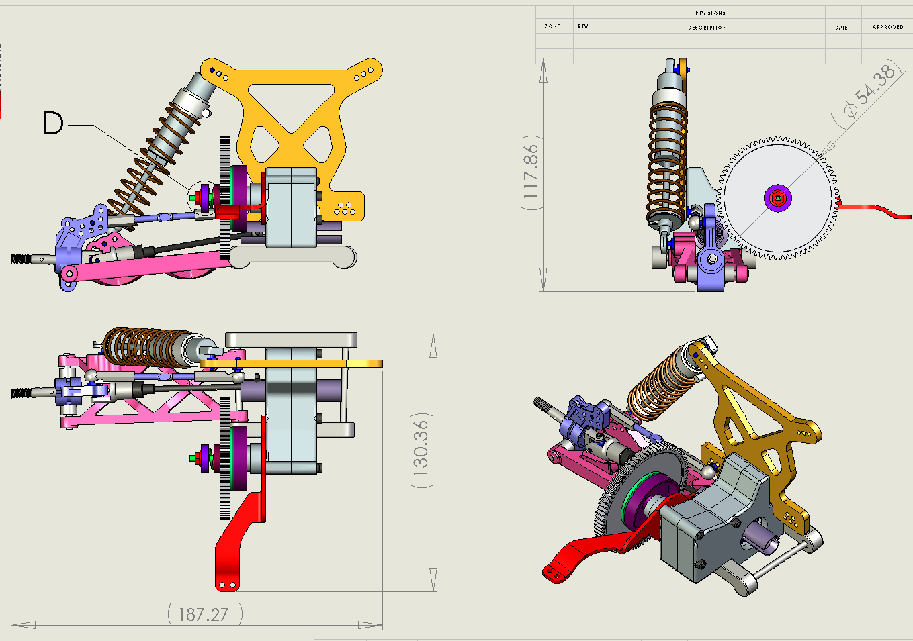

Slide 3
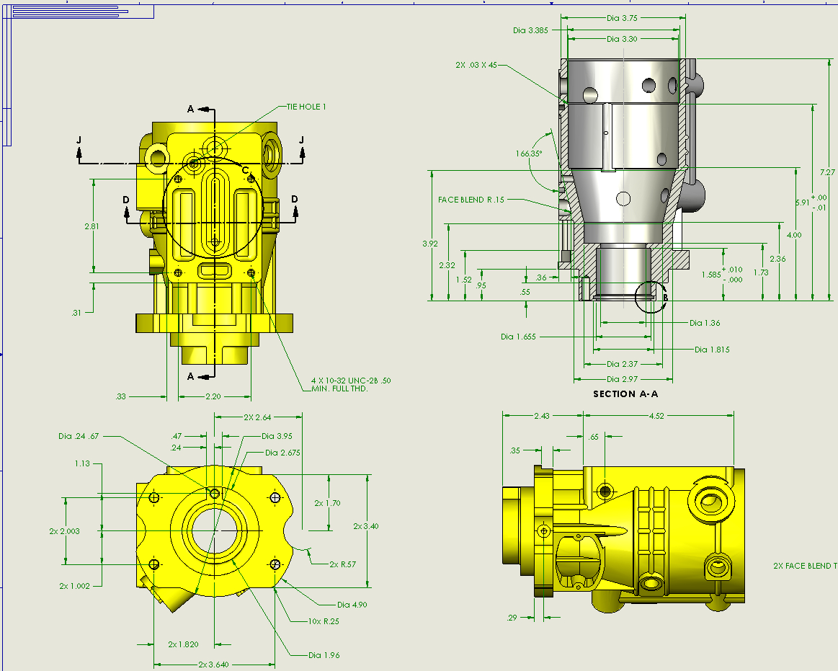

Slide 4
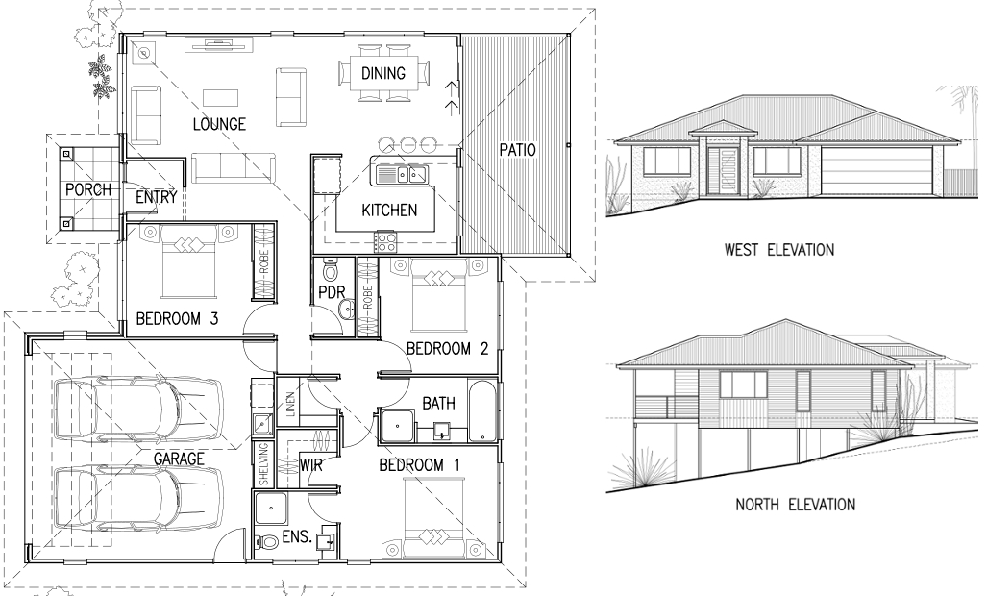

Slide 5
If you want to know more (not needed anywhere in GCSE or A-level maths!), read about - First-angle projection - Third-angle projection on Wikipedia here. This tells you “which elevation is which” if there are no East, West labels.

