Slide 1
“Different units for different purposes”
(1) Length

Slide 2

How long is a Scottish midge?

Slide 3
Units of length

Slide 4
Some approximate lengths
1 inch = 2.54 cm, 1 foot = 30.48 cm, 1 m = 3.2808 ft
Height of a man 6 feet = 1.8 m
Length of a car 12 feet = 3.6 m
Height of a house 25 feet = 7.5 m
Length of a coach 42 feet = 13 m
Length of the swimming pool 82 feet = 25 m
5 miles = 8 km

Slide 5
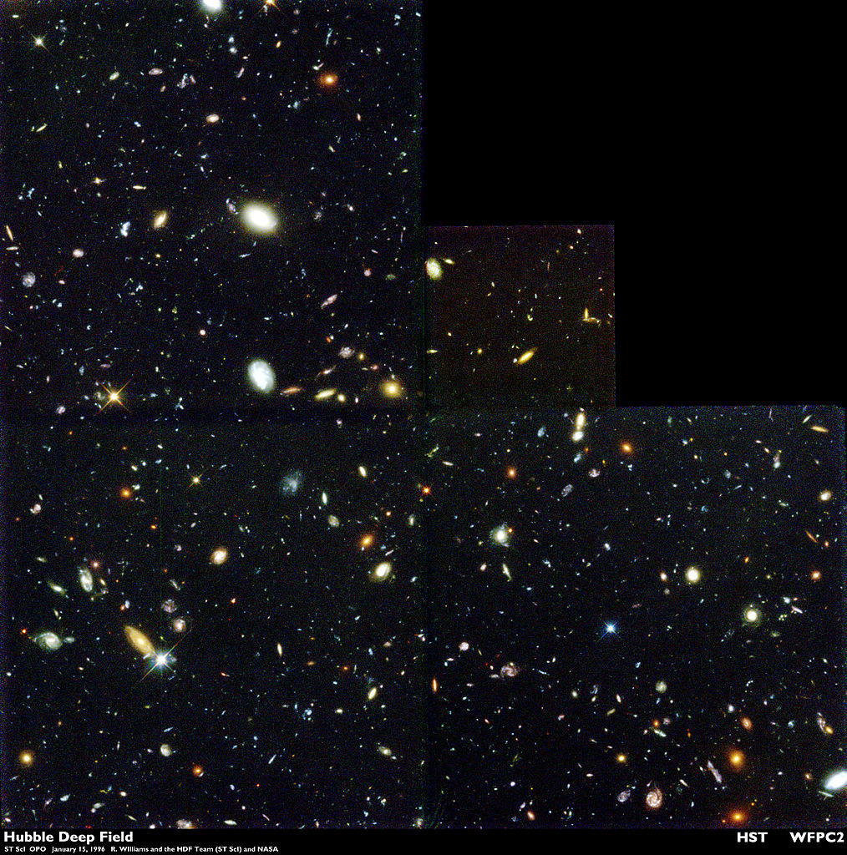

Slide 6
For huge distances, we can use standard form
1 light year = 6 million million miles
= 6×10¹² miles = 9.4×10¹⁵ metres
Distance to nearest star (apart from Sun)
= 4.2 light years
= 4×10¹⁶ metres
You don’t need to remember this!!!

Slide 7
Converting length units
We know 5 miles = 8 km, hence:
“100 times as far”
“Twice as far”
the “unit multiplier”

