Slide 1
What is area?
“Acres and football pitches”
Big areas
Little areas
Area of a rectangle =
Width × height

Slide 2
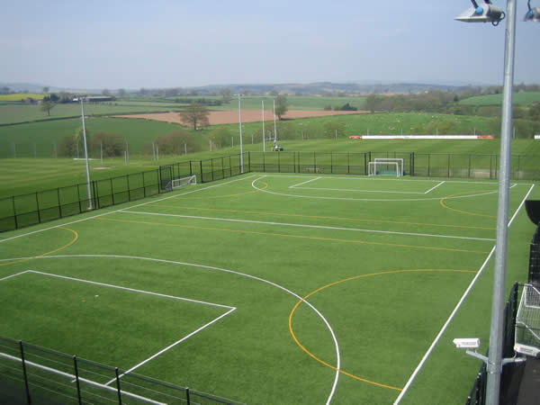
Football pitch, area 1.76 acres
= 7140 square metres = 105 m by 68 m.

Slide 3
Big areas (to scale)
1 square mile = 2,560,000 m²
= 2.56 km²
= 640 acres
1 square kilometre (1 km²)
= 1,000,000 m²
=100 hectares
1 hectare = 10,000 m²
1 football pitch, 7140 m²
1 acre = 4047 m²

Slide 4
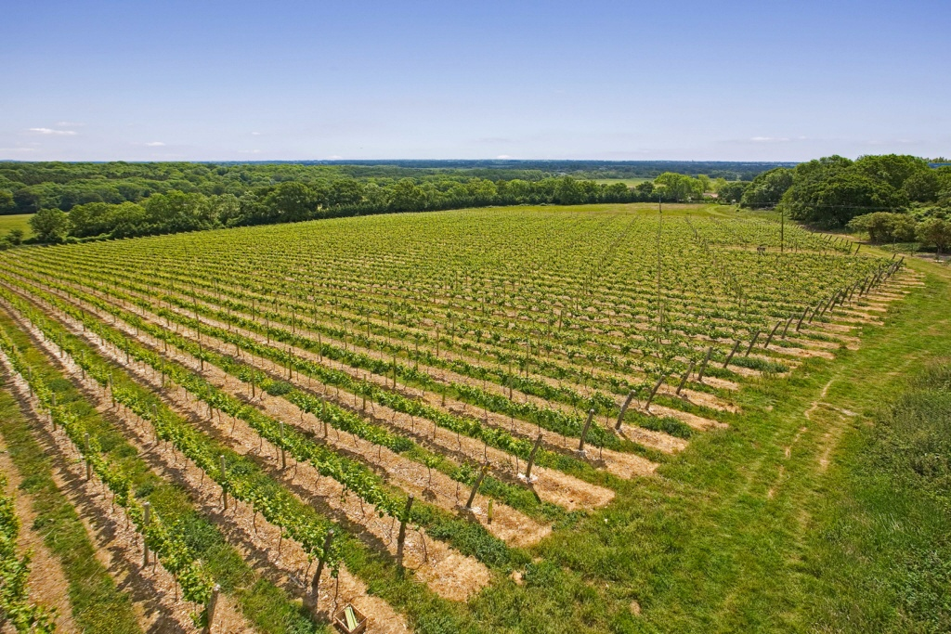
A vineyard, area 10 acres
(40500 square metres, 0.0405 km²).

Slide 5
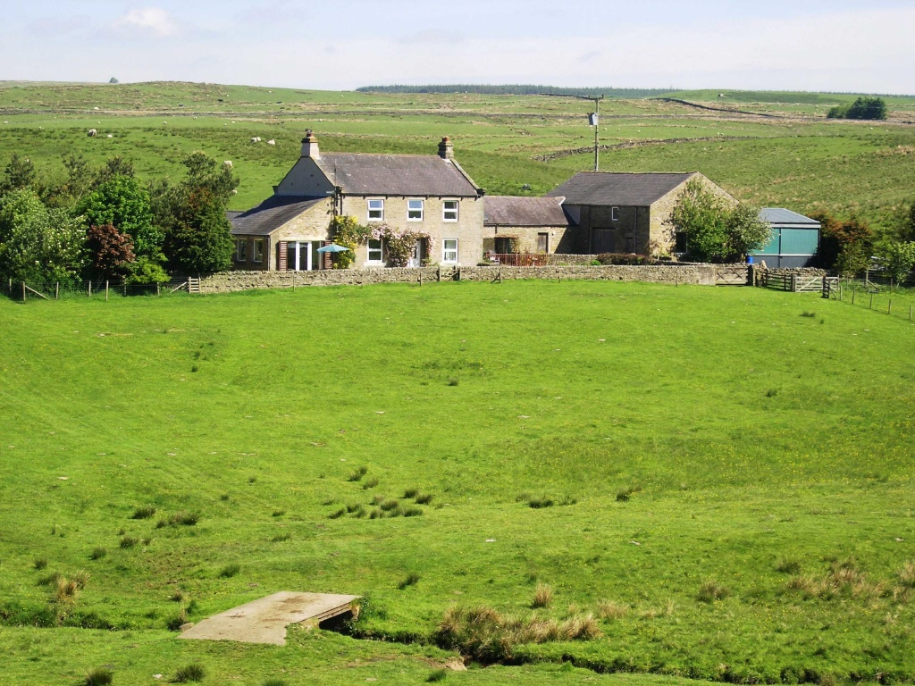
“A farmhouse with 67 acres”

Slide 6
Units
We know:
2 km = 2000 m
but…..
What is 2 km² ?
“The kilo is part of the units”
1 square kilometre ( 1 km² ) is a unit of area.
2 square kilometres is twice that area

Slide 7
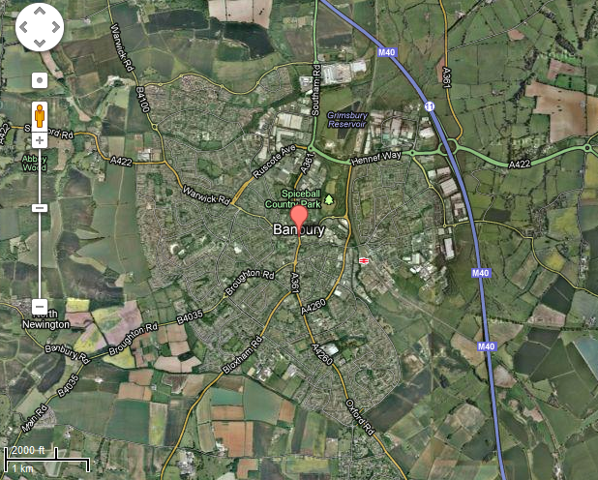
Banbury covers an area of about 12 km².

Slide 8
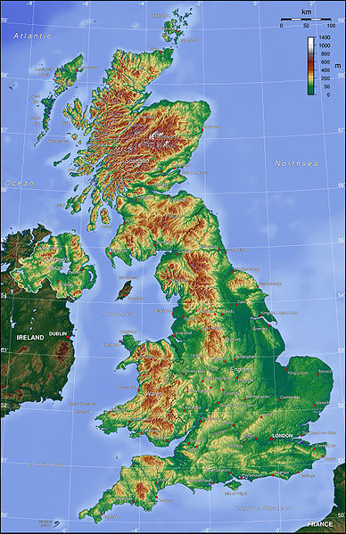
Great Britain,
area 244,000 km².
Population density 255 people per square kilometre.

Slide 9
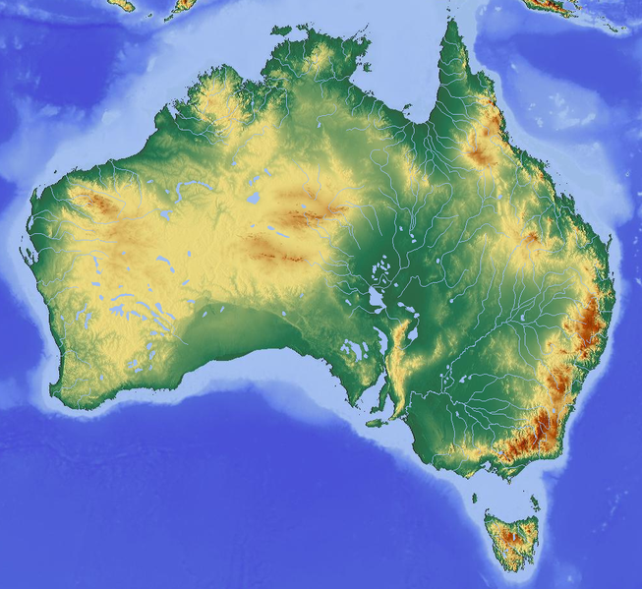
Australia, area 7,600,000 square kilometers (km² ).
Population density 3 people per square kilometre.

Slide 10
Small areas (1) – to scale
1 square mile = 2,560,000 m²
1 square kilometre = 1,000,000 m²
=100 hectares
1 hectare = 10,000 m²
1 football pitch, 7140 m²
1 acre = 4047 m²

Slide 11
Small areas (2)
1 acre = 4047 m²
1 m²

Slide 12
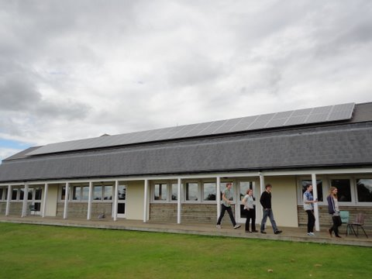
Solar panels, 40 m².

Slide 13
Small areas (3)
1 square metre (1 m²)
A4 paper
624 cm²
1 cm²
(0.5 cm by 2 cm)

Slide 14

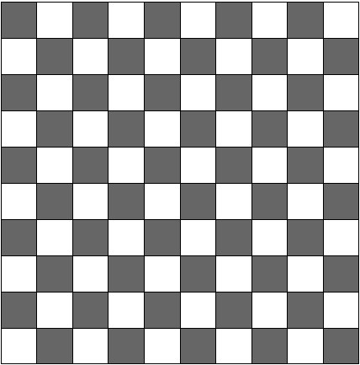
Area 1 mm × 1 mm
= 1 mm²
Total area 10 mm × 10 mm
= 100 mm²
Total area 1 cm × 1 cm
= 1 cm²
1 cm² = 100 mm²

Slide 15

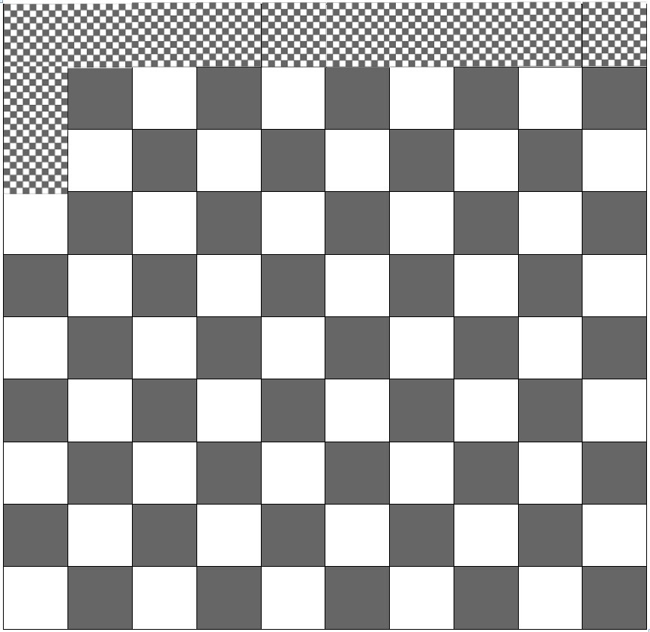
Tiny black squares 1 cm²
Bigger black squares 100 cm².
Total area 10 cm × 10 cm
= 100 cm²
1 m² = 10000 cm²
Total area 100 cm × 100 cm
= 10,000 cm²
= 1 m²

Slide 16
Just to help you remember:
Length | Area
km -> m, × 1000 | km² -> m², × 1,000,000
m -> mm, × 1000 | m² -> mm², × 1,000,000
m -> cm, × 100 | m² -> cm², × 10,000
cm -> mm, × 10 | cm² -> mm², × 100
(and divide to go the other way).
Really you are multiplying by a “unit multiplier” e.g.

